Slide 1
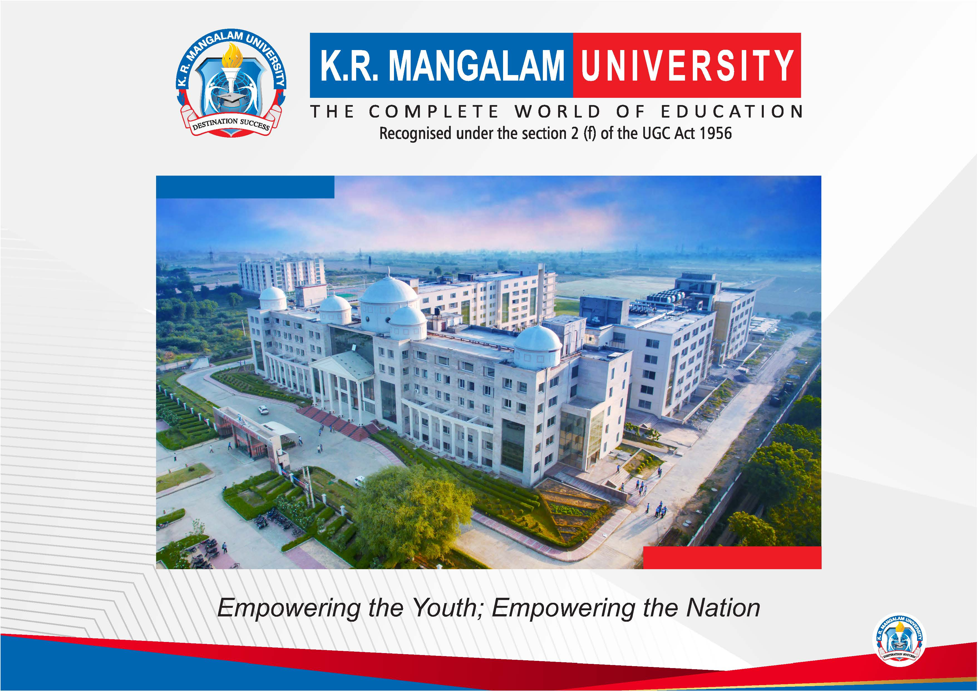

Slide 2


SUBTITLE TRANSLATOR WITH API
Pre-Final Year Project Progress
Submitted by
ROLL | NAME
2301730080 2301730085 | Aditya Chauhan Nyasha Das
2301730090 | Avinash Tiwari
Industry Mentor:
Faculty Mentor:
Notes:
New Courses replaced with New Programmes

Slide 3

Project Overview
The Subtitle Translator project is a web-based application designed to translate subtitle files into different languages in an efficient and automated manner. The system mainly works with SRT (SubRip Subtitle) files, which are commonly used to store subtitle text along with timestamps for synchronization with audio or video media.
In this project, users can upload an SRT subtitle file and select a target language for translation. The system extracts the subtitle text from the file and sends it to an AI-based translation API. The translated text is then placed back into the original SRT format while keeping the original timestamps unchanged. This ensures that the subtitles remain synchronized with the media.
The application is developed using React.js for the frontend and Node.js with Express.js for the backend. By automating subtitle translation, the system helps reduce manual effort, saves time, and improves accessibility for multimedia content available in different languages.
Overall, the project demonstrates how Artificial Intelligence and modern web technologies can be combined to solve real-world problems related to language barriers in digital media.
Notes:
New Courses replaced with New Programmes

Slide 4
Specific Objectives
• To design and develop a web-based system for translating SRT subtitle files into different languages.
• To automatically extract subtitle text from the uploaded SRT file while maintaining the original timestamps and formatting.
• To integrate an AI-based translation API for accurate and efficient language translation.
• To ensure that the translated subtitles remain synchronized with the original media content.
• To provide a simple and user-friendly interface for uploading subtitle files and downloading the translated output.
• To reduce the manual effort and time required for subtitle translation.
• To improve accessibility of multimedia content for users who speak different languages.
Notes:
New Courses replaced with New Programmes

Slide 5
Key Features
• SRT File Support: The system is designed to work specifically with SRT subtitle files, which contain subtitle text along with timestamps for synchronization with media content.
• Automatic Subtitle Translation: The application automatically translates subtitle text into the selected target language using an AI-based translation API.
• Timestamp Preservation: The original timestamps of subtitles are preserved to ensure that translated subtitles remain synchronized with the video or audio.
• User-Friendly Interface: The system provides a simple and easy-to-use interface where users can upload subtitle files and select the desired language.
• Fast Processing: The subtitle translation process is completed quickly, reducing the time required for manual translation.
• Downloadable Output: After translation, users can download the translated subtitle file in the same SRT format.
• Web-Based Application: The project runs on a web platform, making it easily accessible through a browser without requiring additional software.
Notes:
New Courses replaced with New Programmes

Slide 6
Progress Summary
• The project topic “Subtitle Translator System” has been finalized after discussing the idea and feasibility with the project guide.
• Initial research and literature review have been conducted to understand subtitle formats, especially the SRT file structure and how subtitles are synchronized with media content.
• The basic project workflow and system flowchart have been designed to explain how subtitle translation will be processed.
• The required tools and technologies, including React.js, Node.js, Express.js, and Translation API, have been selected for system development.
• The team has started working on frontend design and backend structure to handle file upload and subtitle processing.
• Initial testing of translation APIs and SRT file parsing has been explored to ensure proper subtitle extraction and translation.
• The project is currently in the development phase, where individual modules are being designed and implemented.
Notes:
New Courses replaced with New Programmes

Slide 7
Detailed Progress – Development Phase
• Project Planning: The project idea and scope were finalized after discussion with the project guide. The overall workflow and system functionality were defined to understand how the subtitle translation process will work.
• Research and Analysis: Initial research was conducted on subtitle formats, especially the SRT file structure, to understand how subtitles store text and timestamps. This helped in planning how the subtitles would be extracted and processed.
• Technology Selection: The required technologies such as React.js for frontend, Node.js and Express.js for backend, and an AI-based translation API were selected for building the system.
• System Design: The basic system architecture and flowchart were created to explain the working of the subtitle translation process, including file upload, subtitle extraction, translation, and generation of the translated SRT file.
• Frontend Development: Work has started on designing the user interface where users can upload subtitle files and select the target language for translation.
• Backend Development: The backend structure has been planned to handle file processing, API communication, and generation of the translated subtitle file.
• Testing and Integration: Initial testing of subtitle parsing and translation API integration has been explored to ensure that subtitle text can be translated while preserving the original timestamps.
Notes:
New Courses replaced with New Programmes

Slide 8
Methodology
METHODOLOGY
The development of the Subtitle Translator System follows a structured approach to ensure efficient processing and translation of subtitle files.
• File Upload: The process begins when the user uploads an SRT subtitle file through the web interface. The system accepts the file and prepares it for processing.
• Subtitle Parsing: The uploaded SRT file is read and parsed to extract the subtitle text and timestamps. This step helps separate the actual subtitle content from the timing information.
• Text Extraction: Only the subtitle text is selected for translation while the original timestamps are preserved to maintain synchronization with the media.
• Translation Process: The extracted text is sent to an AI-based translation API, which converts the subtitle text into the selected target language.
• Subtitle Reconstruction: After translation, the system reconstructs the subtitle file by inserting the translated text back into the original SRT structure along with the existing timestamps.
• Output Generation: Finally, a new translated SRT subtitle file is generated and provided to the user for download.
Notes:
New Courses replaced with New Programmes

Slide 9
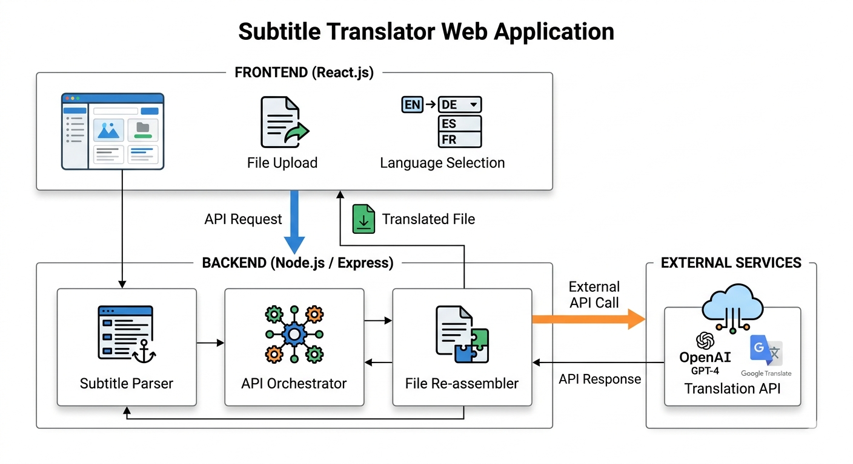

Prototype/Project Flow diagram/Architecture
Notes:
New Courses replaced with New Programmes

Slide 10
Project Timeline
Phase 1 – Project Planning (Week 1–2) • Finalization of project topic and scope • Discussion with project guide • Initial research on subtitle translation and SRT file structure
Phase 2 – Requirement Analysis (Week 3–4) • Study of system requirements and features • Selection of tools and technologies such as React.js, Node.js, and Translation API • Preparation of system flowchart and project design
Phase 3 – System Design (Week 5–6) • Designing the system architecture • Planning the workflow for subtitle extraction, translation, and reconstruction • Preparing UI layout for the application
Phase 4 – Development Phase (Week 7–10) • Frontend development using React.js • Backend setup using Node.js and Express.js • Implementation of SRT file parsing and translation API integration
Phase 5 – Testing and Integration (Week 11–12) • Testing subtitle translation functionality • Ensuring timestamps remain synchronized with media • Fixing errors and improving system performance
Notes:
New Courses replaced with New Programmes

Slide 11
Next Steps and Goals
• Complete System Development: Continue developing the remaining modules of the application, including subtitle parsing, translation integration, and output generation.
• API Integration: Successfully integrate the AI-based translation API with the backend system to enable accurate subtitle translation.
• User Interface Improvement: Enhance the frontend interface to make the application more user-friendly and easier to navigate.
• Testing and Debugging: Conduct proper testing to identify and fix errors, ensuring that subtitle timestamps remain synchronized with the media content.
• Performance Optimization: Improve the speed and efficiency of subtitle translation and file processing.
Notes:
New Courses replaced with New Programmes

Slide 12
Data & Resources
• SRT Subtitle Files: The primary data used in this project is SRT (SubRip Subtitle) files, which contain subtitle text along with timestamps for synchronization with media content.
• Sample Subtitle Datasets: Various publicly available subtitle files from movies, educational videos, and online media sources will be used for testing the translation process.
• AI-Based Translation API: A translation API will be used to process and convert subtitle text into different languages automatically.
• User Input Data: Users can upload their own SRT subtitle files, which will serve as input data for the translation system.
• Testing Data: Different subtitle files with varying lengths and languages will be used to evaluate the system’s performance and translation accuracy.
Notes:
New Courses replaced with New Programmes

Slide 13
Project Usecases & Scope
Use Case
• Multimedia Content Translation: The system can be used to translate subtitle files for movies, videos, and educational content into different languages.
• Educational Platforms: Online learning platforms can use the system to translate subtitles of lectures and tutorials so that students from different language backgrounds can understand the content.
• Content Creators: Video creators and media producers can use the system to generate subtitles in multiple languages for their videos.
• Global Accessibility: The project helps make digital media accessible to a wider global audience by overcoming language barriers.
Scope
• The system focuses on translating SRT subtitle files while preserving the original timestamps and structure.
• It supports multiple language translations using an AI-based translation API.
• The project is designed as a web-based application that allows users to upload subtitle files and download translated output.
• The scope of the project is limited to subtitle text translation only and does not modify the video or audio files.
• The system can be further expanded in the future to support real-time translation and additional subtitle formats.
Notes:
New Courses replaced with New Programmes

Slide 14
Expected Results & Impact
Expected Results
• The system will successfully translate SRT subtitle files into different languages using an AI-based translation API.
• The translated subtitles will preserve the original timestamps, ensuring proper synchronization with the video or audio content.
• Users will be able to upload subtitle files and download the translated output easily through a simple web interface.
• The system will reduce the manual effort and time required for subtitle translation.
• The application will demonstrate the integration of web technologies and AI-based language translation.
Impact
• Improved Accessibility: The project will help users understand multimedia content available in different languages.
• Time Efficiency: Automated subtitle translation will save time compared to manual translation methods.
• Support for Content Creators: Video creators and educators can easily generate subtitles in multiple languages.
• Educational Value: The project provides practical experience in AI integration, web development, and file processing.
• Global Reach: The system can help make digital media accessible to a wider international audience.
Notes:
New Courses replaced with New Programmes

Slide 15
THANK YOU

